Slide 1

TRAINING CONTENT
Kubernetes networking
Session-2
Image Placeholder

Slide 2
Lecture Outline
Container-to-container communications
Pod-to-Pod communications
Pod-to-Service
External-to-Service
CNI Plugins

Slide 3
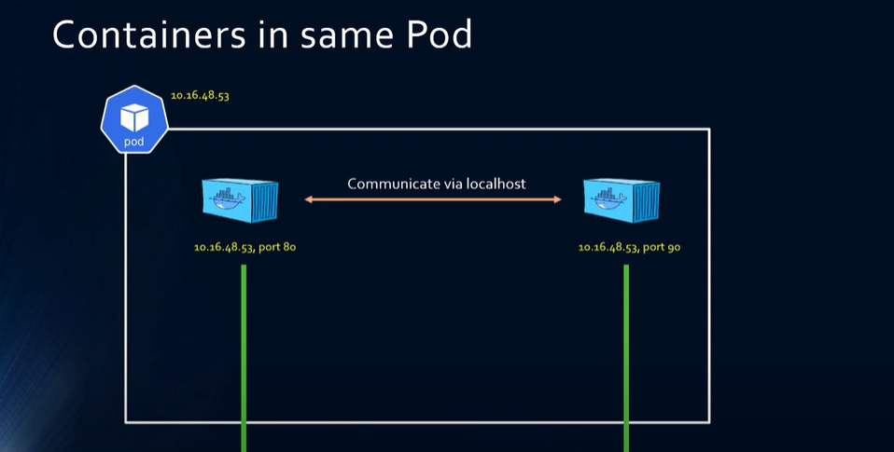
Container to container communication
Container share same network namespace
Container communicate via local host

Slide 4
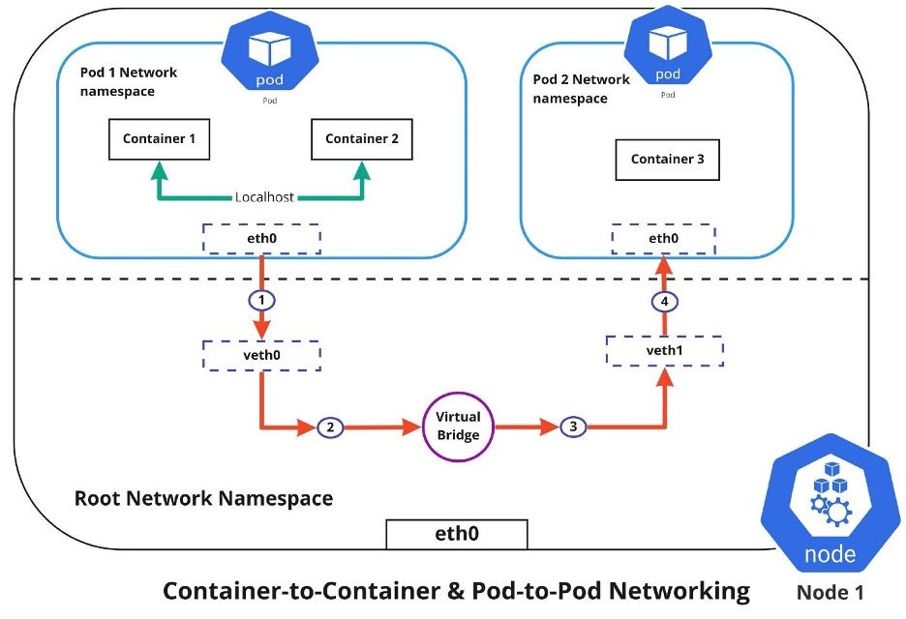
Pod to pod communication
Each pod get’s own IP
All pods communicate with all other pod
All nodes can communicate with all pods
Pod Ip is same through out the cluster

Slide 5
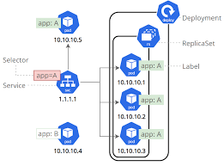
Service to pod communication
Every pods has label
A pod may have multiple labels
Service select pod based on label on pod

Slide 6
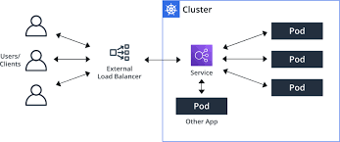
External to service communication
External users communicate with service
Service communicates with pods
Pods get selected according to their match labels

Slide 7
CNI Plugins
Available CNI Plugins
Flannel
Weave
Calico
Cilium
Azure CNI
AWS VPC CNI
Antrea

Slide 8
Thank You
Image Placeholder

